Slide 1
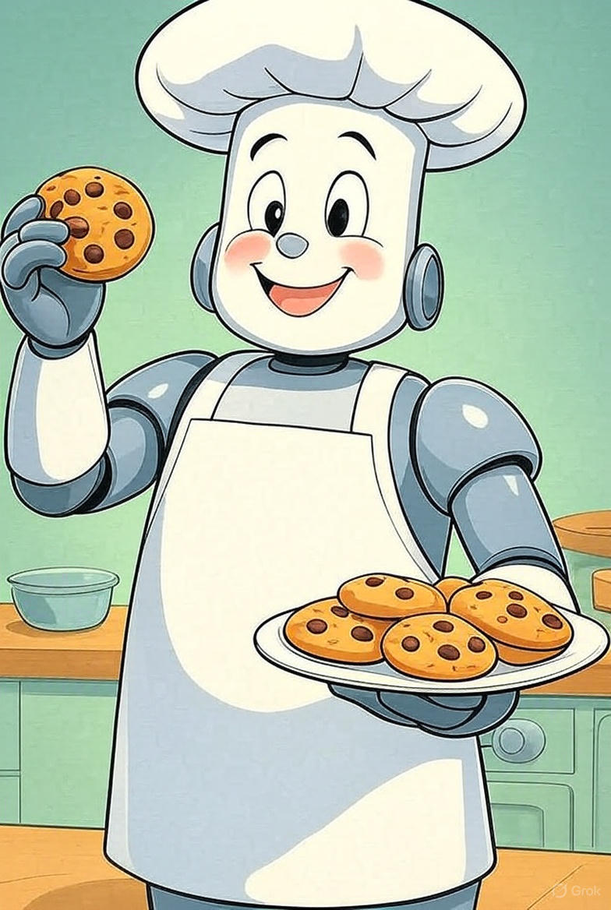
How a Robot Chef Learns to Bake: Weights, Bias, and Activation Functions
A Fun Way to Understand How Computers Learn, One Cookie at a Time! 🍪 Group 5: Joseph Hiller, Courtney Bernard, Marvin Azuogu🍪
“Hi everyone! Today, we’re learning how computers learn by visiting our Deep Learning Bakery. Think of data as our flour, sugar, and eggs. Our goal is to bake the perfect batch of smart cookies!”

Slide 2
Table of Contents
3
Meet Chef Bot
8
How Chef Bot Learns
4
The Problem
9
Connecting to Real AI
5
What Are Weights?
10
What We Learned
6
What Is Bias?
11
Sources
7
What Is an Activation Function?

Slide 3
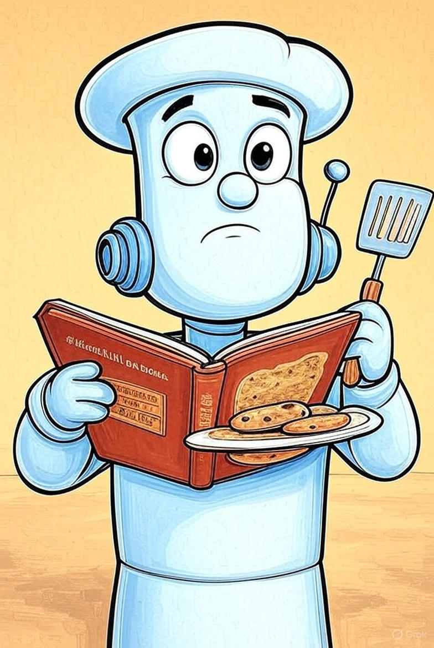
Meet Chef Bot
This is Chef Bot, a robot who loves baking cookies. But there’s a problem. Every batch tastes different, with some being too sweet and some too plain.
Chef Bot needs to figure out how to bake the perfect cookie.

Slide 4

The Problem
Chef Bot doesn’t know how much of each ingredient to use: sugar, flour, butter, and chocolate chips
He needs a way to learn from his mistakes and make better cookies each time.”

Slide 5
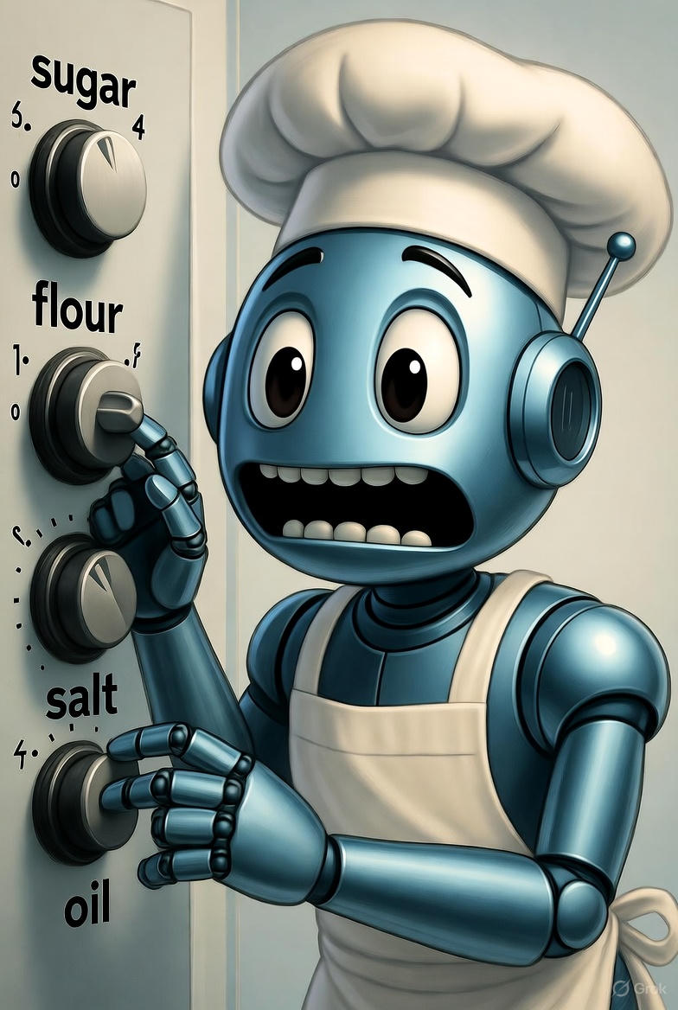
What Are Weights?
WEIGHTS = How much of each ingredient you use
🥛 Milk: 2 cups (weight = 2)
🥚 Eggs: 3 (weight = 3)
🧈 Butter: 1 stick (weight = 1)
Chef Bot gives each ingredient a weight, a number that tells how important it is.
If cookies are too plain, he increases the weight of sugar.
If they’re too sweet, he lowers it.
Weights = how important each ingredient is.

Slide 6
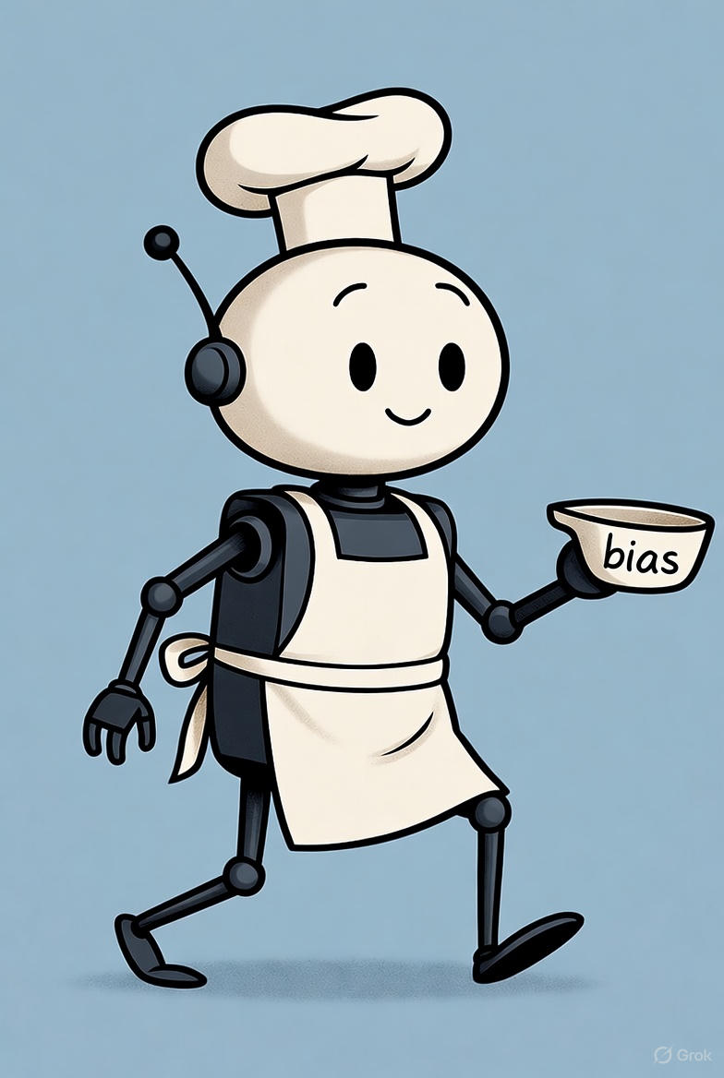
What Is Bias?
BIAS = Your secret ingredient that makes cookies special!
🍯 Like adding a spoonful of honey for extra flavor
It shifts the taste in a good direction!
Even after adjusting ingredients, sometimes the cookies still need a little boost.
Chef Bot adds a tiny extra spoon of sugar, just enough to improve the taste.
That small adjustment is called bias.

Slide 7
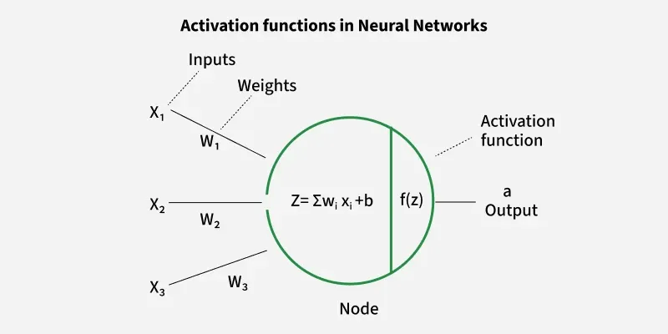
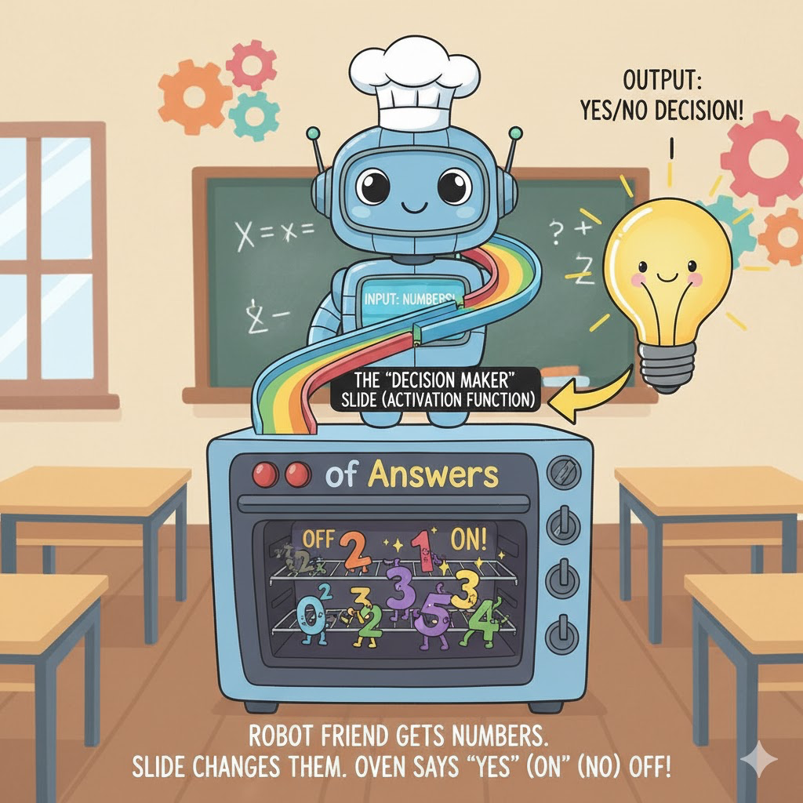
What Is an Activation Function?
ACTIVATION FUNCTION = Your taste test!
😋 "Is it yummy enough to serve?"
🤔 "Does it meet my standards?"
It decides if the cookie passes or needs work!
Now Chef Bot tastes the cookie using his taste sensor.
If it’s yummy, he says ✅ ‘Yes!’
If it’s not, he says ❌ ‘No!’
This decision step is the activation function.
🍪 It decides if the cookie is good enough.

Slide 8
How Chef Bot Learns
Chef Bot keeps baking, tasting, and adjusting his recipe.
Each time he changes the weights and bias to make the cookies taste better.
That’s how he learns: Just like a computer learns by improving after each try!

Slide 9

Connecting to Real AI
In Deep Learning, computers work just like Chef Bot:
Weights decide what’s important
Bias fine-tunes the result
Activation functions make the final decision
That’s how AI learns to recognize pictures,
sounds, and patterns: step by step!

Slide 10
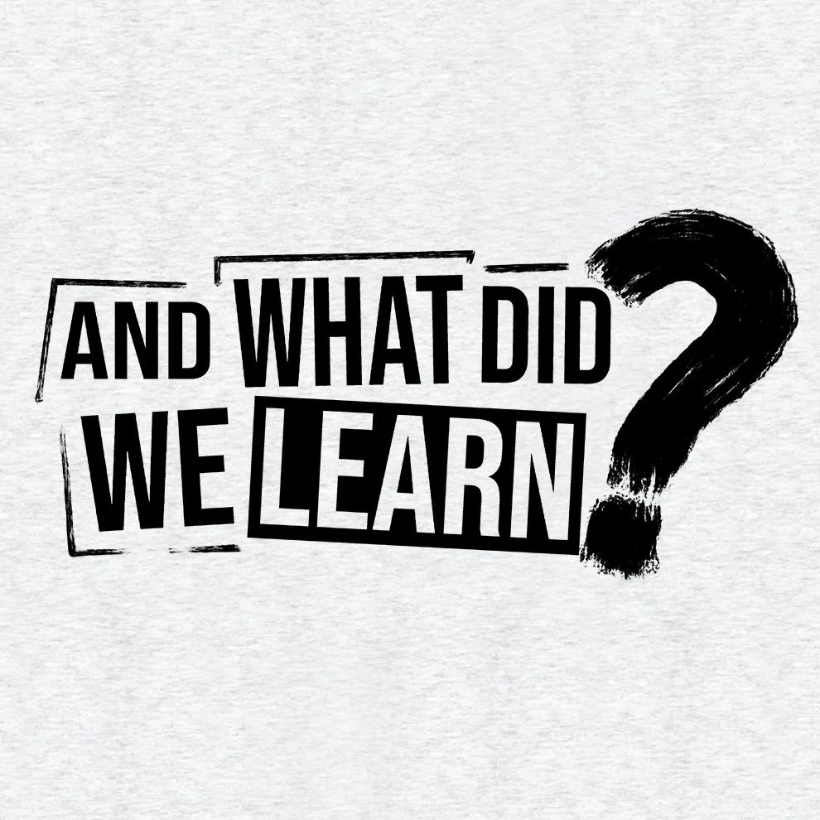
Neural Networks turn data (ingredients) into predictions (cookies).
Using recipes (weights and bias).
Activation functions decide which outputs matter.
They power everything from self-driving cars to smart speakers!
You now understand the basics of deep learning!
What We Learned

Slide 11
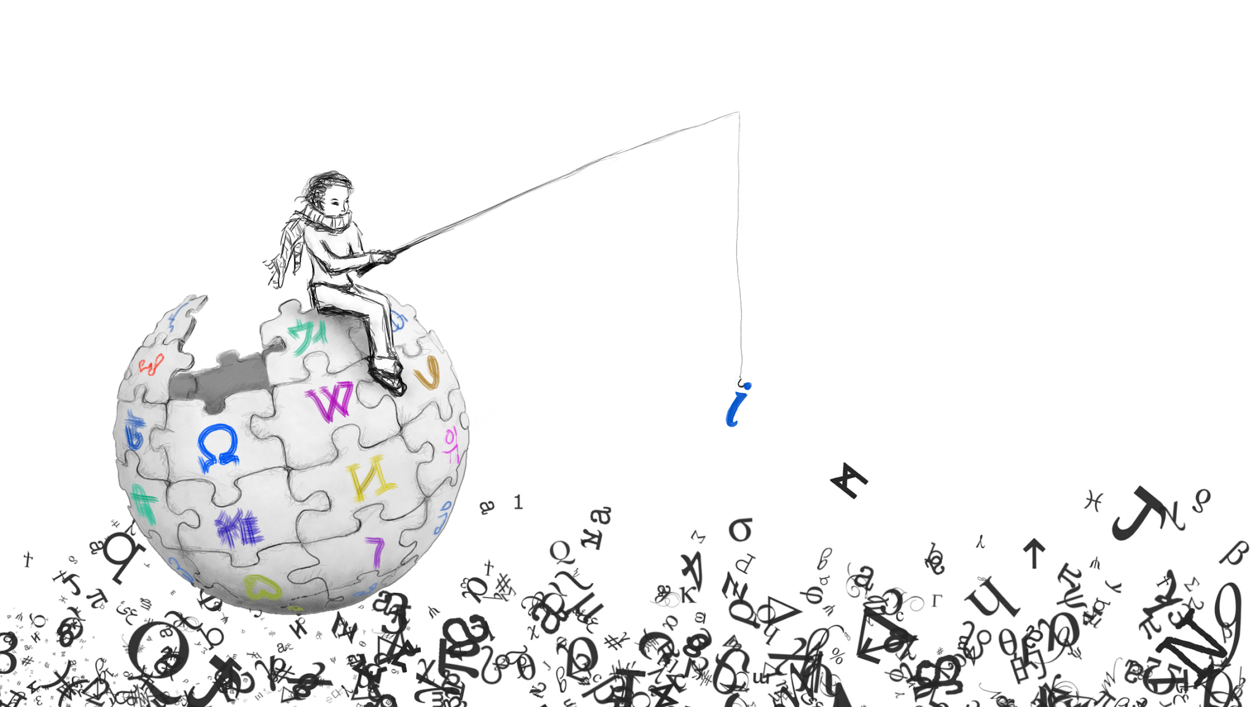

Sources
MIT News. “Explained: Neural Networks.” Massachusetts Institute of Technology, 13 Apr. 2017.
https://news.mit.edu/2017/explained-neural-networks-deep-learning-0414
GeeksforGeeks. “What Is the Role of the Bias in Neural Networks?” GeeksforGeeks, 8 Feb. 2024.
https://www.geeksforgeeks.org/data-science/what-is-the-role-of-the-bias-in-neural-networks/
Encord. “Activation Functions in Neural Networks: 15 Examples.” Encord Blog, 24 Sept. 2025.
https://encord.com/blog/activation-functions-neural-networks/

